Slide 1
CS 2001 Data Structures
Week 4
Lecture 2

Slide 2
Agenda
Doubly linked list
Fundamental functions
Utility functions.
Application - one example where linked lists play vital data structure?

Slide 3
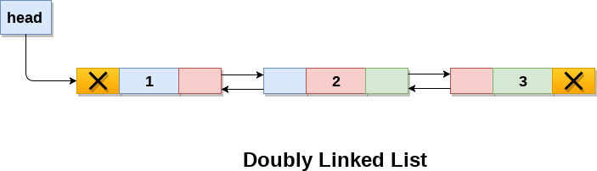
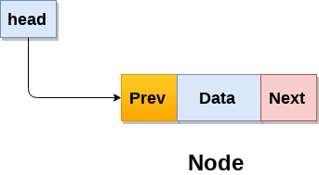
Doubly linked list
A type of linked list in which a node contains a pointer to the previous as well as the next node in the sequence.
Adv: Given a node, it’s easy to visit its predecessor, convenient to traverse list backwards.

Slide 4
Fundamental functions and Utility functions
The following operations are performed on a Doubly Linked List
Traversal: accesses each element of the linked list
Insertion: adds a new element to the linked list
Deletion: removes the existing elements
Search : Finds a node in the list
Sort: Sorts the nodes of the linked list
Reverse: Reverses the list
etc.

Slide 5
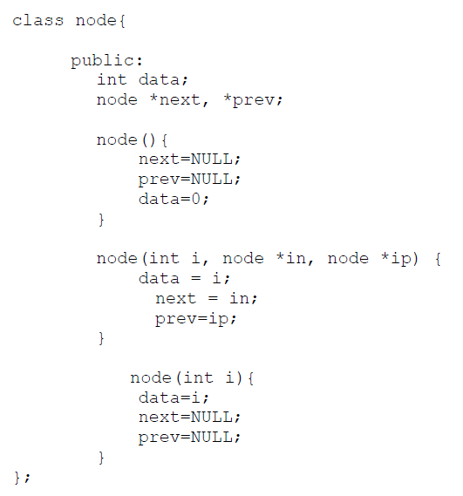
First Simple Linked List in C++

Slide 6
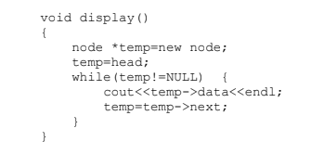
Traverse:

Slide 7
Traverse Backwards
Write yourself??

Slide 8
Insertion
Insert at beginning
Insert at end
Insert at any position

Slide 9
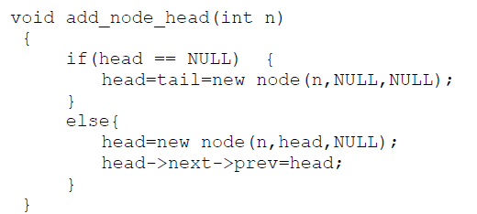
Insert at beginning

Slide 10
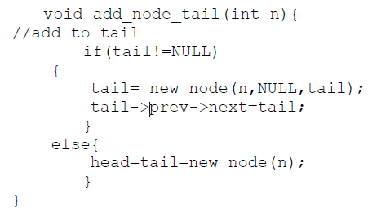
Add_node (Insert at end)
Insert in an empty LL and Insert at end

Slide 11
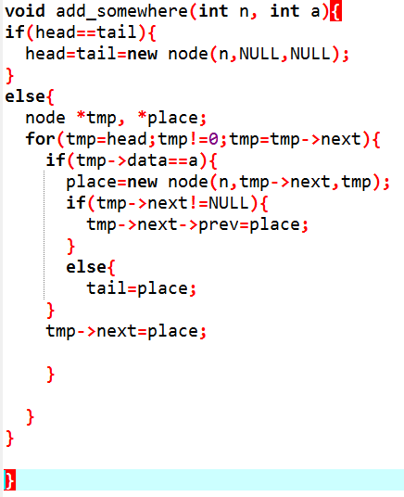
Insert at any position

Slide 12
Deletion
Delete from beginning/start/head/at front
Delete from end
Delete at any position

Slide 13
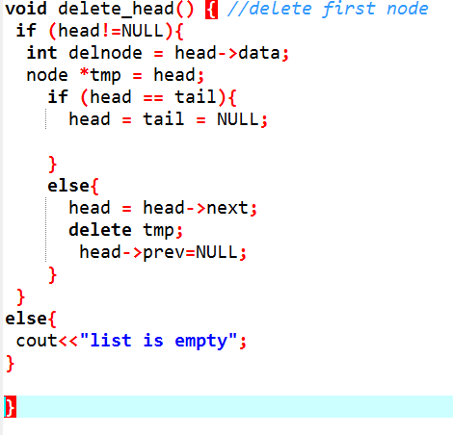
Delete at front

Slide 14
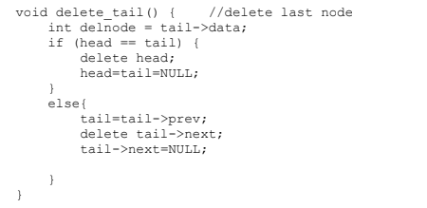
Delete from end

Slide 15
Delete at any position
Do yourself?

Slide 16

Search

Slide 17
Sort
Write yourself?

Slide 18
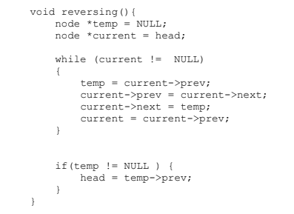
Reverse

Slide 19
Applications discussion
Linked lists are used in variety of applications in computer Science.
It is used very often into operating system concepts and in places where we cannot get a large chunk of memory or we have to use dynamic memory.
For ex, if you have data worth 1.5 GB and you cannot get that much contiguous space in your computer, but you can get at most 0.5 GB of contiguous memory chunk, you can divide the data into 3 parts and then store the location of first chunk somewhere, store the location of second chunk in first chunk, location of third chunk in second chunk and so on. In this way , you can read this large chunk of data without having to bother to store it as a large chunk
Undo functionality in photo editors, text editors. (a linked list of different states)
The cache in browser. (allows you to hit back and fwd links URL’s through linked list)
Image viewer! (next and previous button. the next and previous images are linked there

